Slide 1
Exam Overview 70-532: Developing Azure Solutions
Brian Swiger

Slide 2

Brian Swiger
App Dev Manager for Microsoft
20+ years of development and architecture experience
Microsoft Certified Trainer (MCT) & Solutions Developer
Azure Certified Developer/Architect
Microsoft Learning Experiences (LeX) contributor
@CodeBeing
http://www.mightybs.com
http://aka.ms/brianswiger

Slide 3
Agenda
1
Exam Concepts
2
Exam Topics & Details
3
Study Strategy

Slide 4
Exam concepts
Basics
Scoring
Question Structure

Slide 5
Exam Scoring
Each exam has a “cut score”
Determined during exam creation process
Questions are evaluated for difficulty and a score applied
Each question is worth one point
Unless indicated in the question text, some may be worth multiple points
Complete all questions as no points are deducted for wrong answers
Mark items for later review
You may come back to items you mark unless part of a case study or noted section
Good to mark items for comments as well

Slide 6
Exam Basics
Typically 40 to 60 questions
1 to 4 hours to complete the exam
You can flag questions and review later
You cannot move between case studies
You will be notified when you cannot move back
Make sure to read all screens
700 is the passing score
700 is not 70%
Answer all questions

Slide 7

Question structure
Technical Environment or Scenario
You are a developer…
Problem Statement / Requirements
The app must…
Goal Statement
You need to…
Question statement
What should you do…

Slide 8
Exam Topics & Details
http://aka.ms/70-532

Slide 9
Exam Outline (Skills measured)
Virtual Machines
Storage
Web & Mobile
Identity & Networks

Slide 10
Exam Outline (Skills measured)
30% – 35%
25% – 30%
25% - 30%
15% - 20%
Create and manage Azure Resource Manager (ARM) Virtual Machines
Design and implement a storage and data strategy
Design and implement Azure Platform as a Service (PaaS) compute and web and mobile services
Manage identity, application, and network services

Slide 11
Exam Outline (Skills measured)
Virtual Machines
Storage
Web & Mobile
Identity & Networks

Slide 12



Virtual Machines
Monitoring
Config Mgmt
Networking
Deploying VM Workloads
Scaling
Storage
Management

Slide 13
Overview
Management options
Portal
PowerShell
REST API
Virtual Network
Cloud Service
vnet
vm
Virtual Machine
Data Disk(s)
OS Disk
Storage Account
storage
Image
VM Best Practices

Slide 14
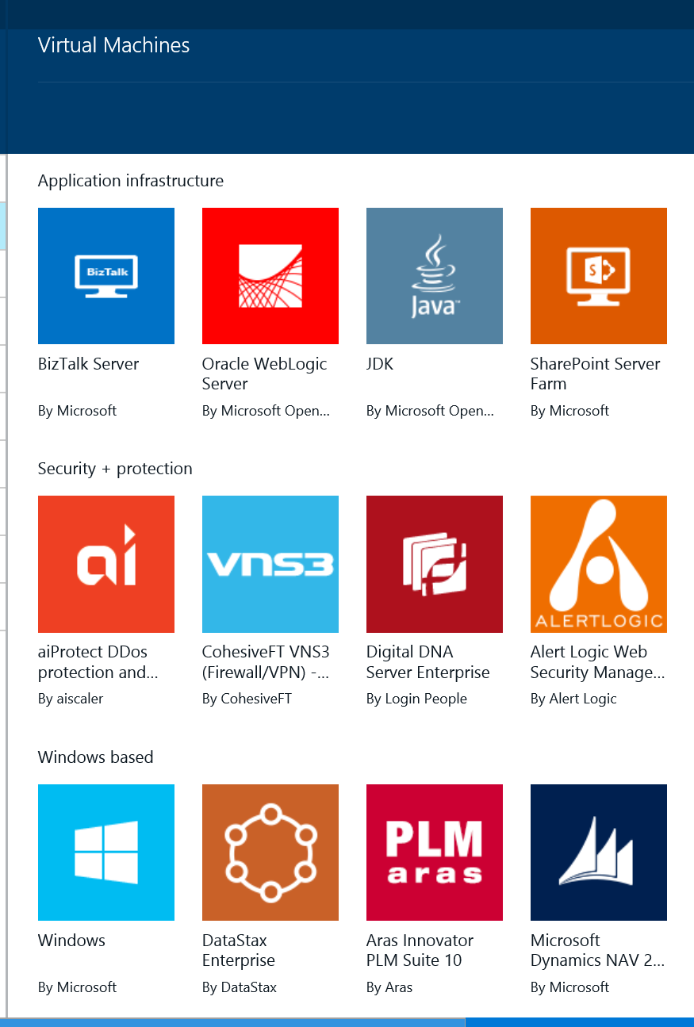
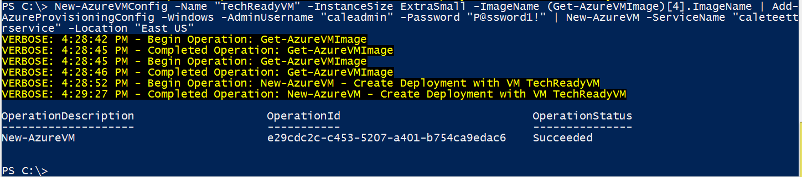
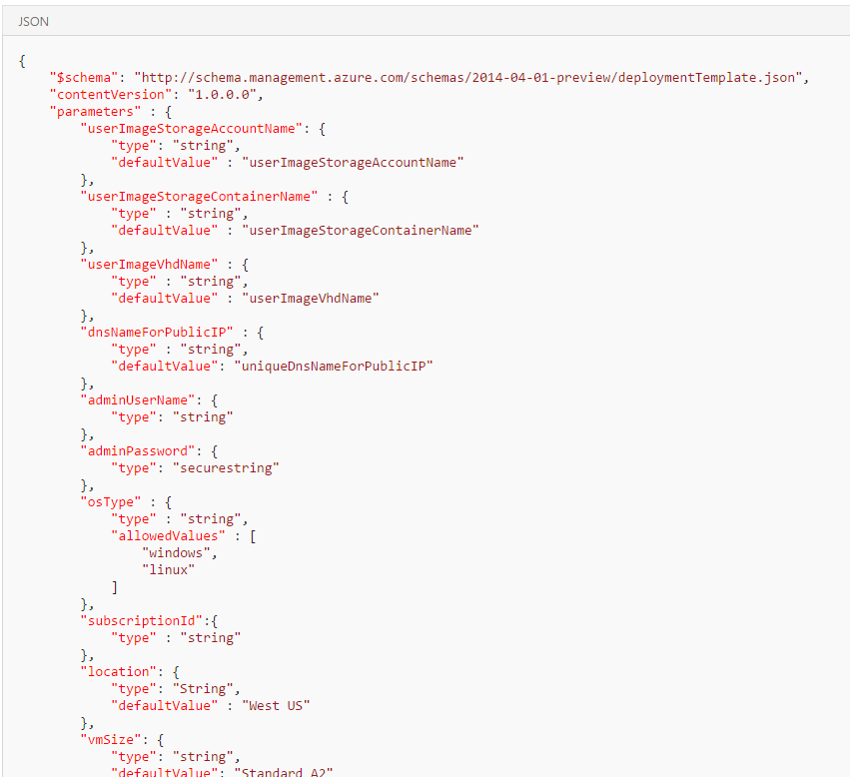
Deployment
Different ways to create a VM

Slide 15
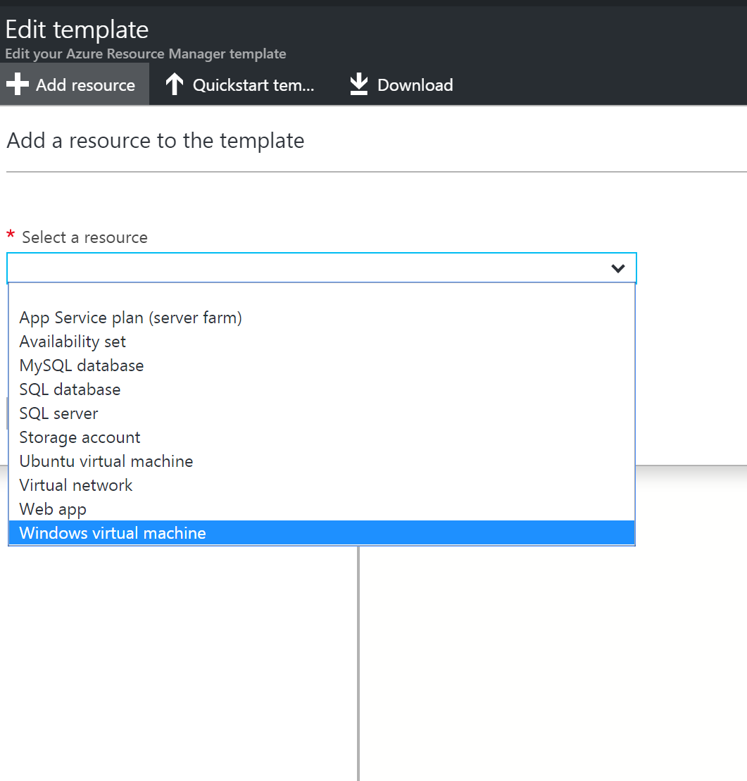
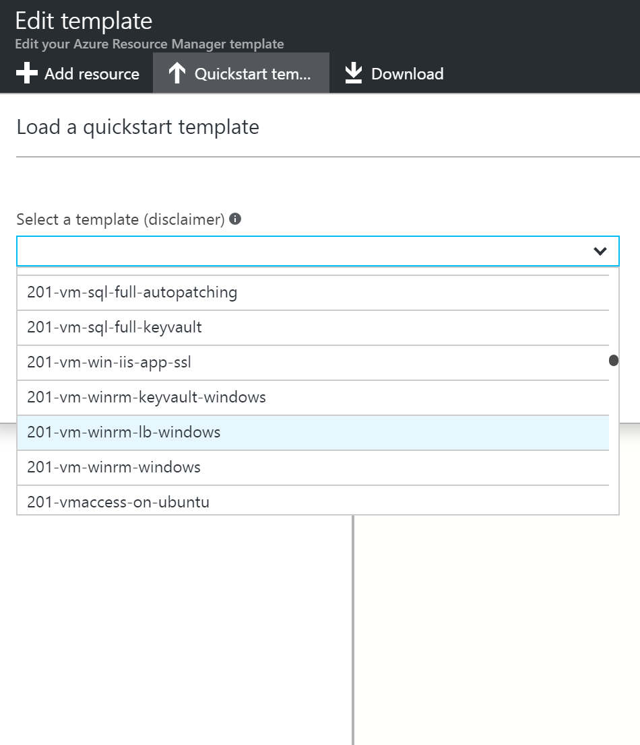
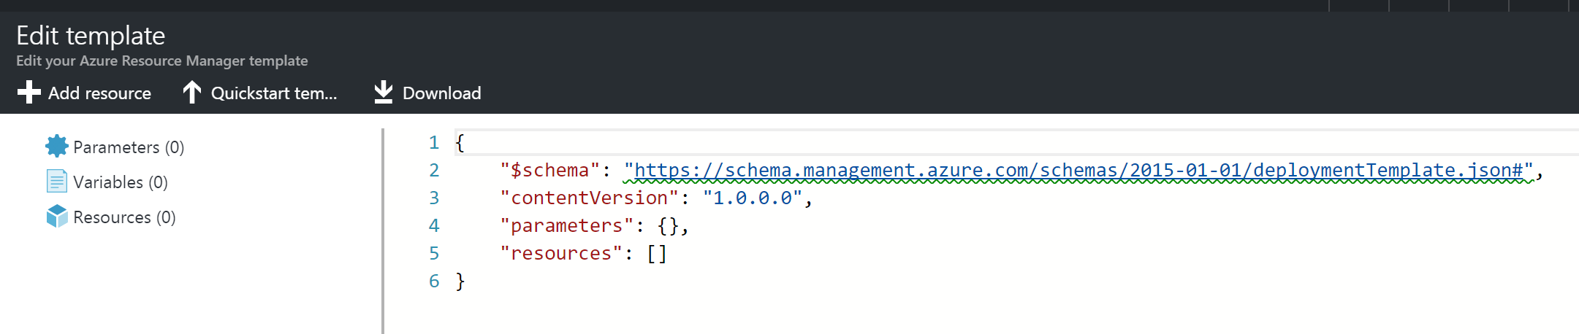
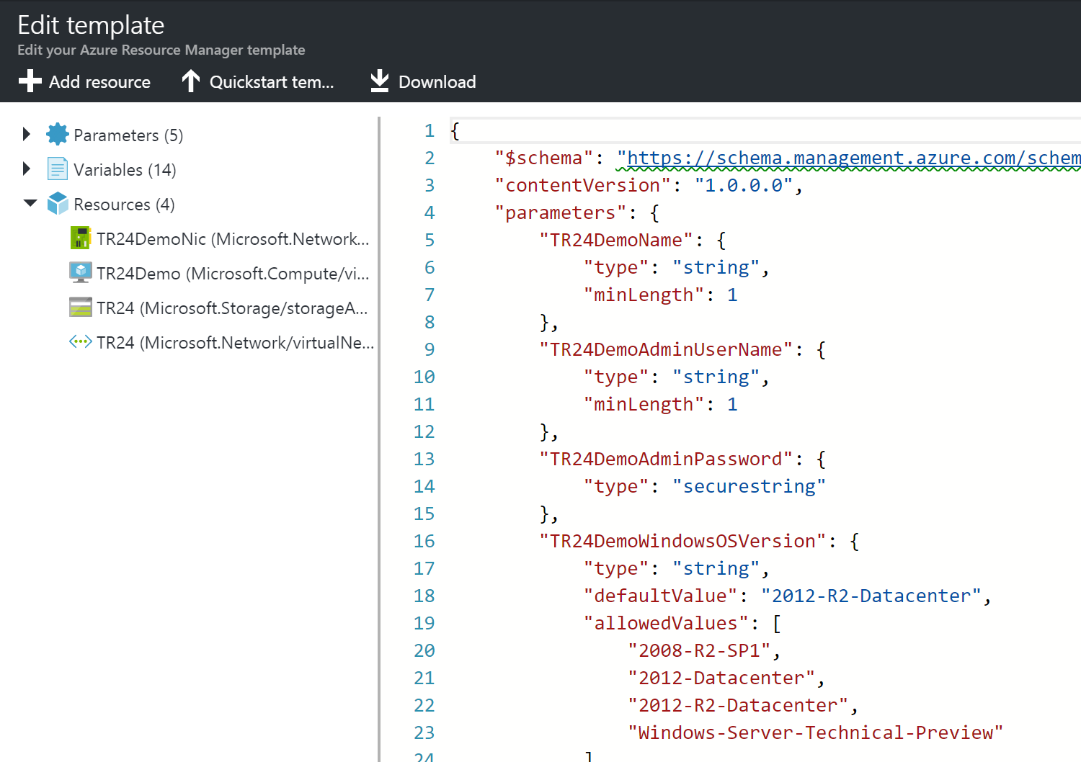
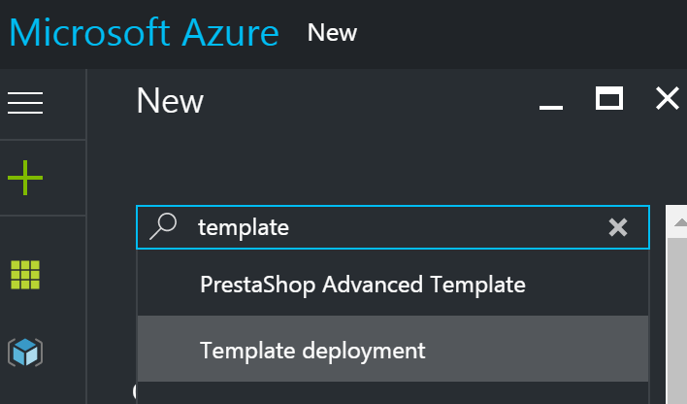
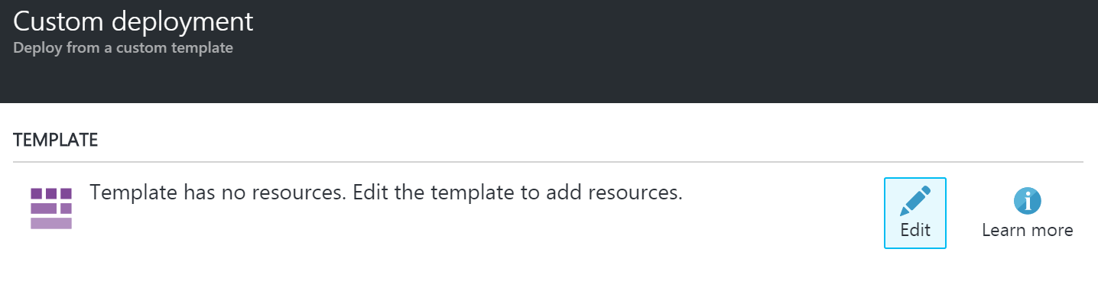
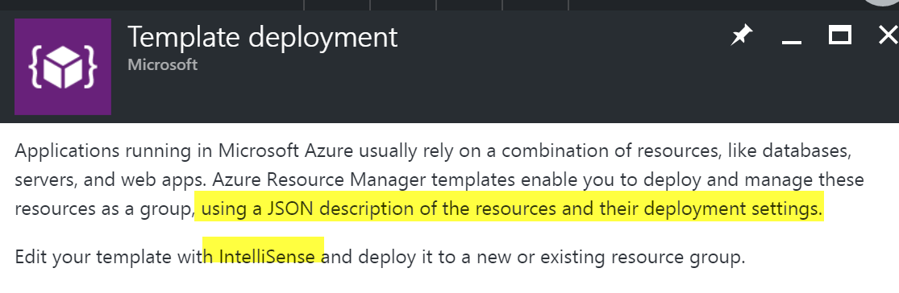
ARM Templates Portal
RM Template Walkthrough

Slide 16
Desired State Configuration
DSC Template Overview
Configuration Contosoweb app
{
param ($MachineName)
Node $MachineName
{
#Install the WebServer
WindowsFeature IIS
{
Ensure = "Present"
Name = "Web-Server"
}
#Install ASP.NET 4.5
WindowsFeature ASP
{
Ensure = "Present"
Name = "Web-Asp-Net45"
}
}
}

Slide 17
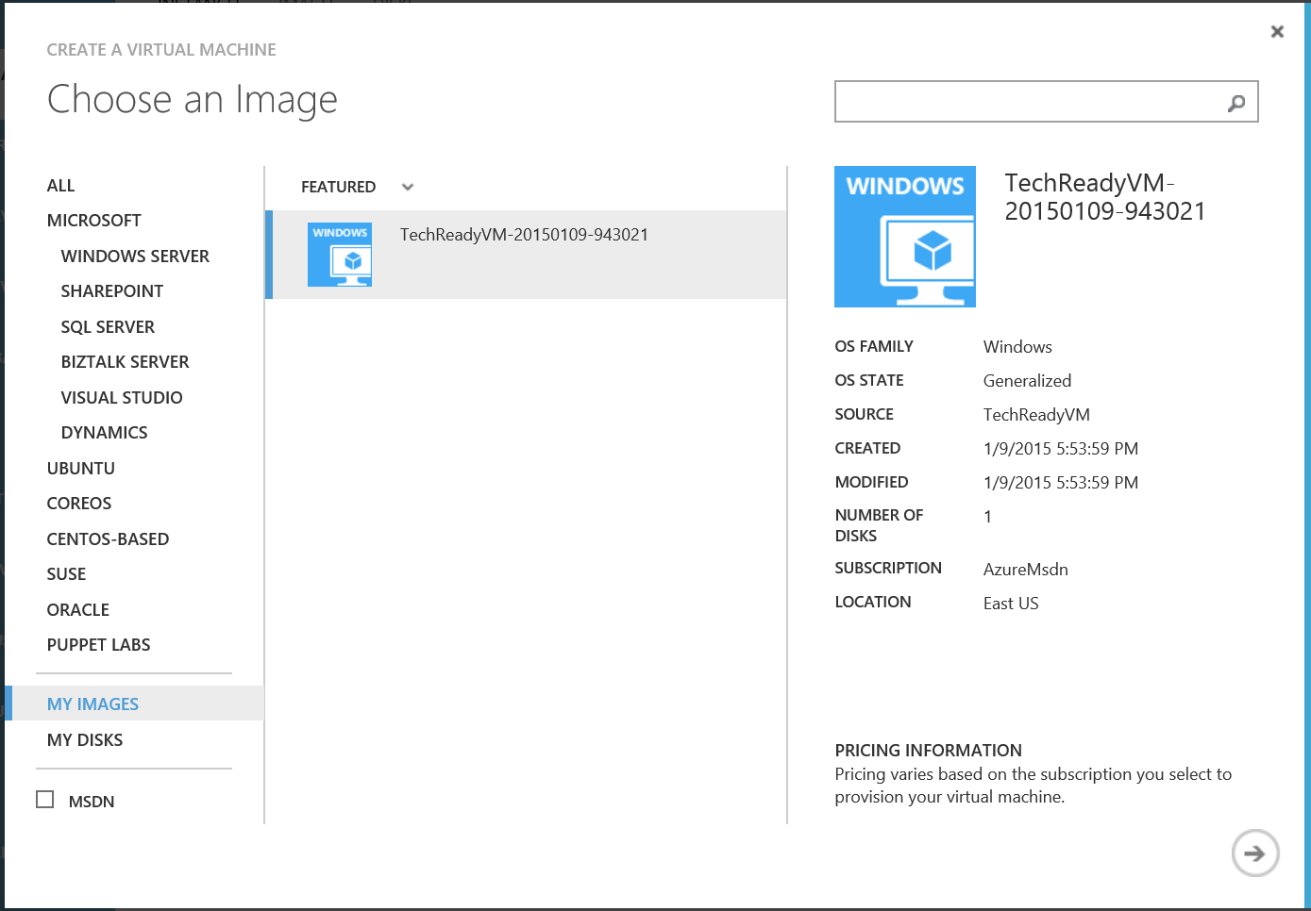
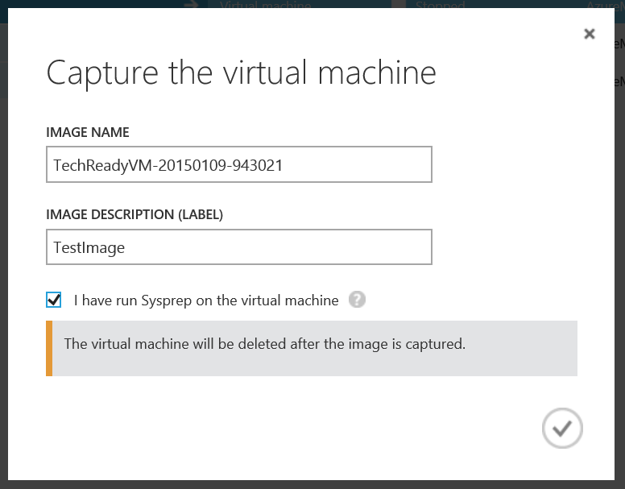
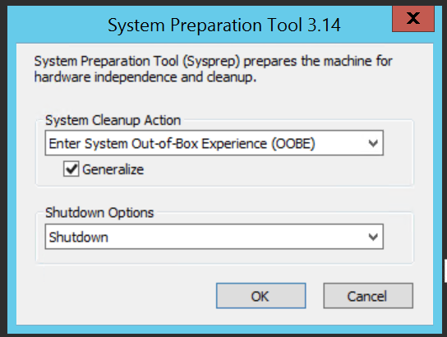
Uploading Images
Generalize a Windows VM

Slide 18
Availability sets
Planned vs unplanned maintenance
Configure multiple virtual machines in an availability set for redundancy
Configure each application tier into separate availability sets
Combine a Load Balancer with availability sets
Use multiple storage accounts for each availability set
Upgrade domains
Five (non-user configurable) domains by default
Groups of VMs and hardware that can be rebooted at the same time
Fault domains
Three domains by default
group of virtual machines that share a common power source and network switch
Separate hardware & network
Manage the availability of VMs
How to create an availability set

Slide 19
Storage replication options
Locally redundant
Default
Up to three nodes in the same data center
Zone redundant storage
Up to three data centers in the same region
Geo-redundant storage
Data center in a different region
Read-access geo-redundant storage
Data center in a different region
Secondary data can be read
Azure Storage replication

Slide 20
ARM VM Storage
Configure disk caching
Input/output operations per second (IOPS)
Throughput (Mbps)
Read/write vs Read and striping
Storage capacity
Sizing and egress traffic limits
Azure File service
SMB file shares
File system I/O APIs
Premium vs Standard
Premium: high-performance, low-latency disk support for I/O intensive workloads
Scalability and Performance Targets
Storage Accounts
Premium Storage

Slide 21
VM Networking
Network Security Group (NSG)
ACL rules allow/deny network traffic
Can only be applied to resources within the region it was created
Diagnostic logging capability
Associating (NSG to Network Interface Card (NIC), NSG to subnet)
ONE NSG to a NIC or subnet
User-Defined Routes (UDRs) / Route Tables
specify the next hop for packets flowing to a specific subnet
Force tunneling to the Internet via your on-premises network
Use of virtual appliances in your Azure environment
Application Gateway
Load balancing
Websocket traffic
Sticky session apps
SSL offload
Network security groups

Slide 22
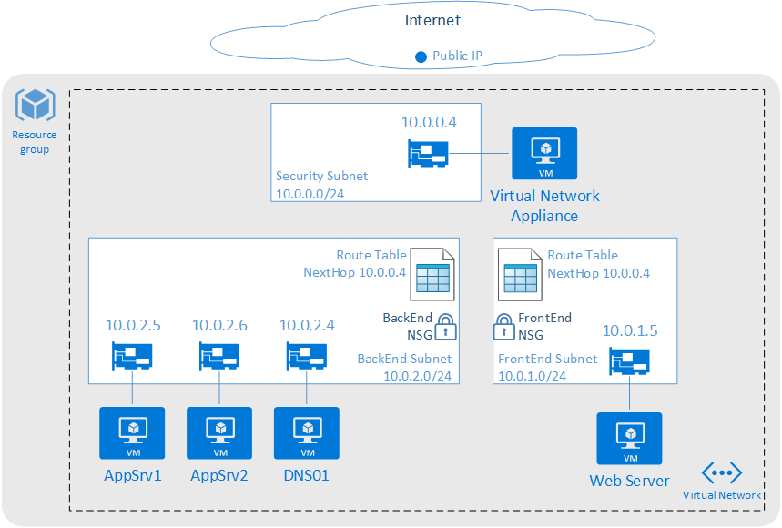
User Defined Routes (UDR) aka “route table”
System Routes
3 Default Rules: Local vNet, On-premises, Internet
Any subnet to another w/in a VNet.
From VMs to the Internet.
From VNet to another VNet via VPN gateway.
From a VNet to another VNet through VNet Peering
From a VNet to on-premises network via VPN gateway.
User Defined Routes
Forced Tunneling
Network Virtual Appliance
Routes selected in order of 1. UDR, 2. BGP (with ExpressRoute), 3. System Route
See aka.ms/Azure/UDR
And aka.ms/Azure/DMZ
UDR
Notes:
You can have multiple route tables
the same route table can be associated to one or more subnets
each subnet can only be associated to a single route table.
All VMs and cloud services in a subnet use the route table associated to that subnet.+
Subnets rely on system routes until a route table is associated to the subnet.
Once an association exists, routing is done based on Longest Prefix Match (LPM) among both user defined routes and system routes.
If there is more than one route with the same LPM match then a route is selected based on its origin in the following order:+
User defined route
BGP route (when ExpressRoute is used)
System route

Slide 23

Virtual Machine Scale Sets
Identical set of VMs
PaaS-like autoscale
Focus is load and elastic in and out
Scaling
PaaS-like autoscale using autoScaleSettings in ARM template
Rules using metricTriggers
Can combine Desired State Configuration (DSC) extension
Initial scale setting using ARM template:
"sku": {
"name": "Standard_A0",
"tier": "Standard",
"capacity": 3
},
Virtual Machine Scale Sets Overview

Slide 24
Exam Outline (Skills measured)
Virtual Machines
Storage
Web & Mobile
Identity & Networks

Slide 25
Storage
Blobs / Files
Tables
Queues
Redis Cache
Access Control
Monitoring
SQL DB
Search

Slide 26

Blobs / Files
devstore
devshare
demo
demo
SMB
REST
SAS TOKEN
blobs
container
account
BLOCK BLOB
Azure VM
Public or Azure
PAGE BLOB
APPEND BLOB
Understanding Block Blobs, Append Blobs and Page Blobs
BLOBS
FILES

Slide 27
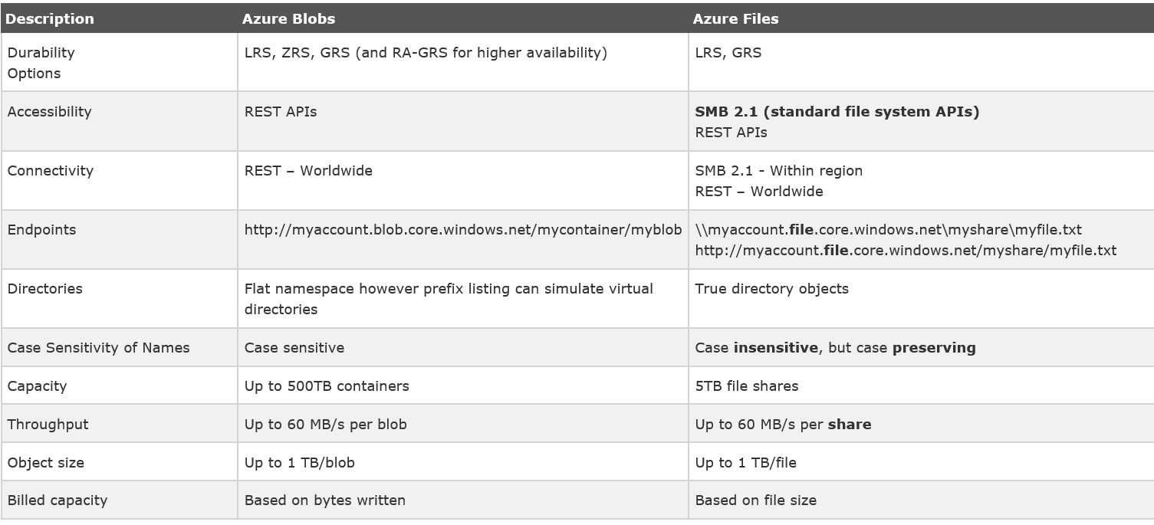
Storage

Slide 28
Tables
ODATA
devtable
demo
SAS TOKEN
TableClient
entities
table
account

Slide 29
Queues
devqueue
QueueClient
demo
SAS TOKEN
entities
table
account
Get started with Azure Queue storage using .NET

Slide 30
Storage access
Blobs
//[account].blob.core.windows.net/[container]/[ blob]
Files
//[account].file.core.windows.net/[file]
Tables
//[account].table.core.windows.net/[table]([paritition key],[row key])
Queues
//[account].queue.core.windows.net/[queue]

Slide 31
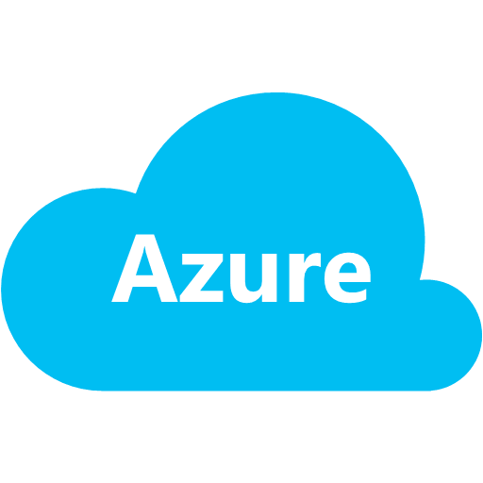
Access control with Shared Access Signature (SAS)
Application
1. Request SAS Token
2.Generated SAS Token
3. Storage request with SAS Token.
SAS Token Service
4. Response
Storage

Slide 32
SQL Database
SQL Database Service Tiers
Small databases
Single active operation
Dev/Test
Small scale apps
5 DTU
Great option for cloud apps
Multiple operations
Workgroup or web apps
10 – 100 DTU
High transaction volumes
Large number of users
Multiple operations
Mission critical apps
100 – 800 DTU
BASIC
STANDARD
PREMIUM
Migration between tiers is possible (Portal, PowerShell or REST API)

Slide 33
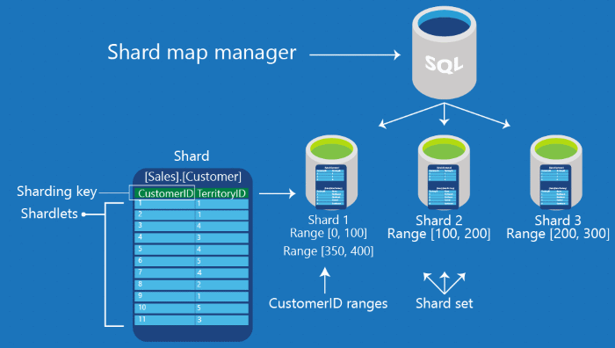
SQL Database
SQL Database Scaling
Maintains global mapping information about all shards (databases) in a shard set
Metadata used to route based on sharding key

Slide 34
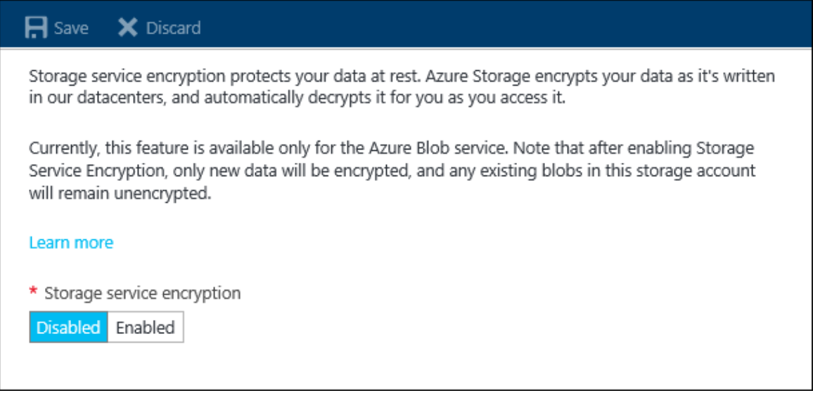
Azure Storage Service Encryption (SSE)
Features
256 BIT AES Encryption
Block, Page and Append Blobs
General purpose and Blob Storage Accounts
All redundancy levels and all Regions
ARM, no ASM
Limitations
Classic storage and Classic migrated
Existing Data before turned on
Tables, Queues, and Files data
https://docs.microsoft.com/en-us/azure/storage/storage-service-encryption
Notes:
Azure Storage Service Encryption - Data can be secured in transit between an application and Azure by using
Client-Side Encryption, HTTPs, or SMB 3.0. Storage Service Encryption provides encryption at rest, handling encryption, decryption, and key management in a totally transparent fashion.
encrypted using 256-bit AES encryption, one of the strongest block ciphers available.+
SSE works by encrypting the data when it is written to Azure Storage
used for block blobs, page blobs and append blobs.
It works for the following:+
General purpose storage accounts and Blob storage accounts
Standard storage and Premium storage
All redundancy levels (LRS, ZRS, GRS, RA-GRS)
Azure Resource Manager storage accounts (but not classic)
All regions

Slide 35
Search
Index
Persistent store of documents
Add data
Push JSON data with .NET SDK or REST API
Pull with indexers supporting Azure storage and .NET SDK or REST API
Handle Results
Total hits and page counts
Layout results
Sorting and filtering
Create an index
Upload data to search
Search pagination and layout

Slide 36
Redis Cache
Tiers
Basic, Standard & Premium
Concurrency
Optimistic vs pessimistic
Distributed app caching
Shared vs Private
Data persistence
Clustering
Caching tiers
Data persistence
Clustering
Caching guidance

Slide 37
Exam Outline (Skills measured)
Virtual Machines
Storage
Web & Mobile
Identity & Networks

Slide 38
Web & Mobile
Web Apps
Mobile Apps
API Apps
Logic Apps
App Service
API Mgmt
Service Fabric
Functions

Slide 39


Azure App Service Build and scale great web and mobile apps
Web apps
Mobile apps
Logic apps
API apps
Auto-patching and auto-scale
.NET, Java, Node.js, PHP, Python
Integrate with SaaS and on-premises
Continuous integration with VSTS, Github, BitBucket, and more
Notes:
Speaker Guidance: use this slide to briefly highlight the capabilities. Don’t spend too much time on each of the following slides, but enough to give people the confidence they can build out apps easily on App Service.
Key talking points:
App Service has everything you need to build apps that target both web and mobile clients from a single app back-end.
Using API Apps, you can connect your app to dozens of popular services like Office 365 and salesforce.com in minutes, and integrate your own APIs so they can be used within any app.
With Logic Apps, you can automate business processes using a simple no-code experience.
App Service handles the underlying infrastructure, removing the need for you to maintain and patch your infrastructure.
When to Use It
App Service is the preferred option for building web or mobile applications because it provides the productivity, scale, performance, and deployment options for most requirements. Use App Service when you want to focus on building unique differentiation for your app and need the infrastructure to just work. Additionally, it’s great for building an API layer which can be exposed to customers, partners and employees securely using the related API Management service. You can use App Service in conjunction with the many other Azure services (Redis Cache or Azure Traffic Manager for instance) to build and deploy powerful apps quickly.

Slide 40
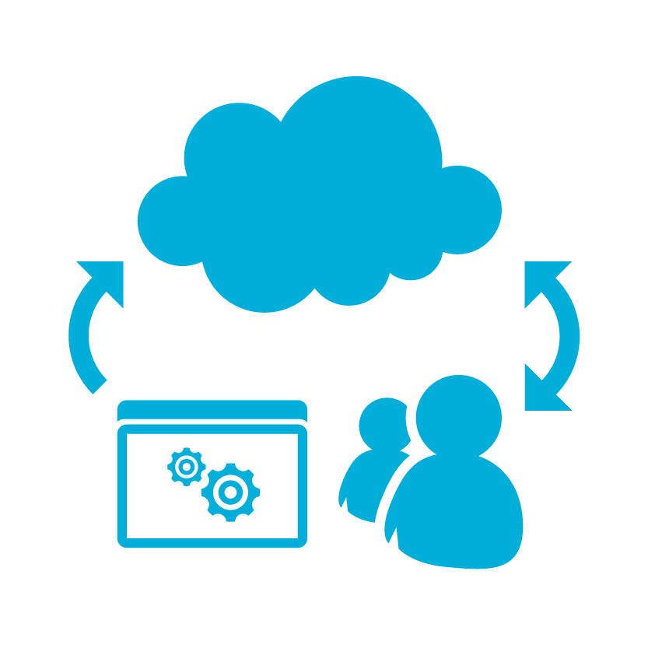



Web Apps
Deployment
Configuration
Diagnostics
Web Jobs
Scaling
Resilience

Slide 41


Hosting
Resource Group
AppSites
ProdSites
App Service Plan
StageSites
Web Apps
Notes:
This slide is required. Do NOT delete. This should be the first slide after your Title Slide. This is an important year and we need to arm our attendees with the information they can use to Grow Share! Please ensure that your objectives are SMART (defined below) and that they will enable them to go in and win against the competition to grow share. If you have questions, please contact your Track PM for guidance. We have also posted guidance on writing good objectives, out on the Speaker Portal (https://www.mytechready.com).
This slide should introduce the session by identifying how this information helps the attendee, partners and customers be more successful. Why is this content important?
This slide should call out what’s important about the session (sort of the why should we care, why is this important and how will it help our customers/partners be successful) as well as the key takeaways/objectives associated with the session. Call out what attendees will be able to execute on using the information gained in this session. What will they be able to walk away from this session and execute on with their customers.
Good Objectives should be SMART (specific, measurable, achievable, realistic, time-bound). Focus on the key takeaways and why this information is important to the attendee, our partners and our customers.
Each session has objectives defined and published on www.mytechready.com, please work with your Track PM to call these out here in the slide deck.
If you have questions, please contact your Track PM. See slide 5 in this template for a complete list of Tracks and TPMs.

Slide 42
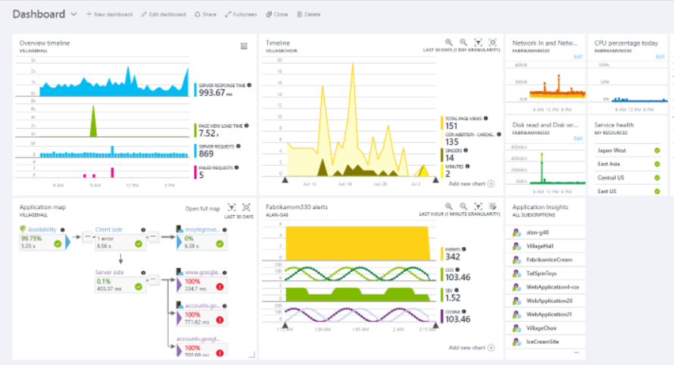
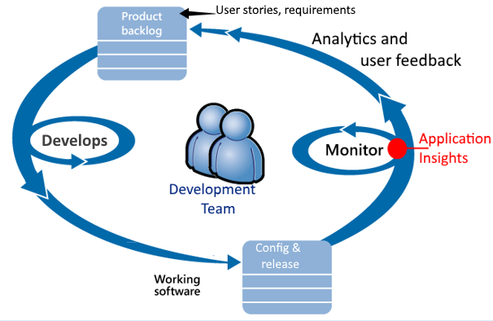
Azure Application Insights
Monitor
WebApps, ASP.NET, Java Apps
Windows Services
Docker apps, JavaScript
SharePoint Sites
Node.js, Objective-C,
PHP, Python, Ruby
DevOps Cycle
Detect, Triage, Diagnose
Monitor Perf, Failures, Usage
aka.ms/azure/AppInsights
Notes:
Application Insights is an extensible Application Performance Management (APM) service for web developers.
aimed at the development team, to understand how app is performing and being used.
MONITOR, DIAGNOSE and ASSESS
Provide ANALYTICS and TELEMETRY
The team uses Application Insights to monitor the live web application closely for:+
Performance. They want to understand how response times vary with request count; how much CPU, network, disk, and other resources are being used; and where the bottlenecks are.
Failures. If there are exceptions or failed requests, or if a performance counter goes outside its comfortable range, the team needs to know rapidly so that they can take action.
Usage. Whenever a new feature is released, the team want to know to what extent it is used, and whether users have any difficulties with it

Slide 43
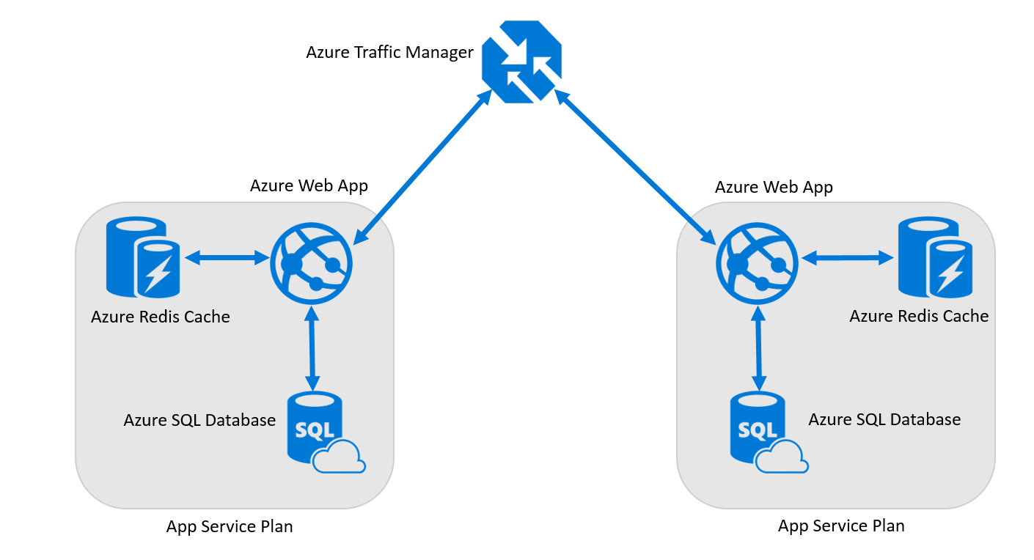
Scaling a web app
Scalable and global web app and database
Scale quickly with a slider bar, from a schedule, or based on CPU load
Route users globally to copies of Web Apps and SQL Databases
Improve performance by using a distributed cache layer
Notes:
Building a simple web app in Azure is easy enough, but any growing company knows that scaling and having global reach for their web apps makes or breaks the business.
To scale an Azure Web App in App Service, you only need to slide a horizontal bar to increase the instance count of the web apps available. But you also want a consistent experience for all users, whether your customer is at an Internet café in Rabat or in a hotel in Mexico City. Choose an Azure datacenter where your web app and database get deployed, and Azure Traffic Manager will route users to the instance of your app closest to their location. Boost your application’s responsiveness by using a distributed cache layer to get content closer to your users.

Slide 44
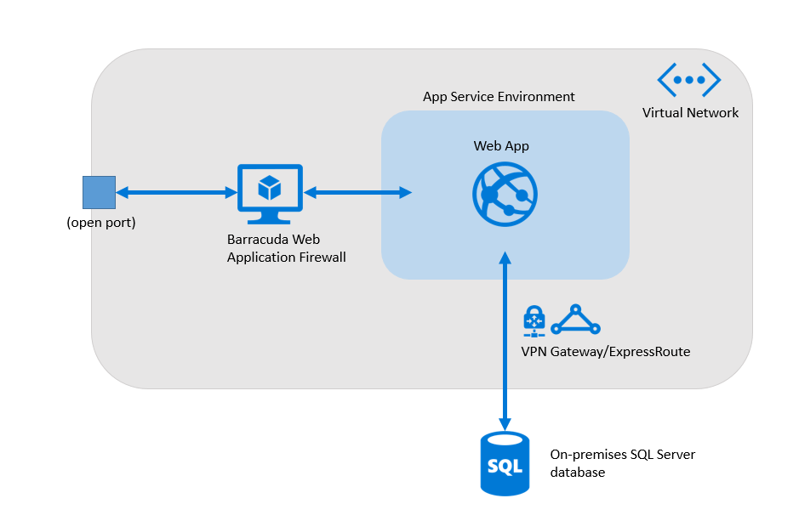
Isolating a web app
Web app with Personally Identifiable Information (PII) and database
Host resources isolated and securely
Block malicious requests through active defense firewalls
Access on-premises resources from a cloud environment with a secure connection
Notes:
Many companies are faced with the requirement of securing apps that hold personally identifiable information (PII). A simple web app hosted publicly in Azure might not meet your security requirements. Instead, you need a locked-down environment with one door to the outside world and active defenses against potential threats.
Solution: use an App Service Environment, surrounded with an Azure Virtual Network. Open one port to the public and use a product like Barracuda Web Application Firewall in front of the App Service Environment so that only approved users can access the apps in the environment. If the database stays on-premises, the Azure Web App in the App Service Environment can access the database via site-to-site VPN or through Azure ExpressRoute.

Slide 45
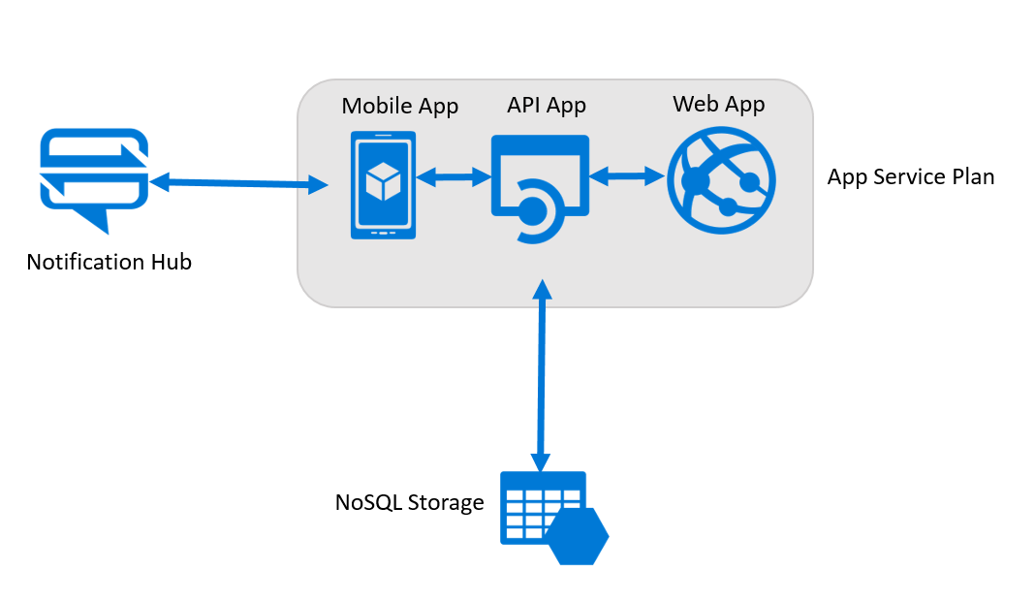
Adding mobile features to a web app
Native or Xamarin-native mobile client app that connects to an Azure Mobile App back end and shares data and APIs with an Azure Web App
Create cross-platform mobile clients easily and consistently
Share data and APIs as-is across mobile and web
Enable mobile back-end features for push notifications, offline data sync, and auto-scaling
Notes:
You have an existing Azure Web App that connects to a storage back end. Your customers expect a mobile experience, so you need to build a mobile app. You would also like to have the mobile app share data and APIs with an existing Web App. Being able to send notifications to users through the mobile app would improve user engagement
Solution: When creating mobile apps, you need to think about the client app functionality and user experience—and also adding shared back-end features like push notifications. You can add these pre-built mobile features and others with Mobile Apps in App Service. Hook in Azure Notification Hubs to send personalized push notifications to users. Then, share data with your Web App and use those back-end features for a complete mobile solution.

Slide 46
WebJobs
On-Demand
Scheduled
web app
AZURE

Slide 47
Creating WebJobs
Uploaded in a zip file
Types
Python
Batch
PowerShell
Java
.NET
Scheduling
settings.job file at root of zip file
{ "schedule": "second minute hour day month dayofweek" }
Or, just use the Azure UI

Slide 48
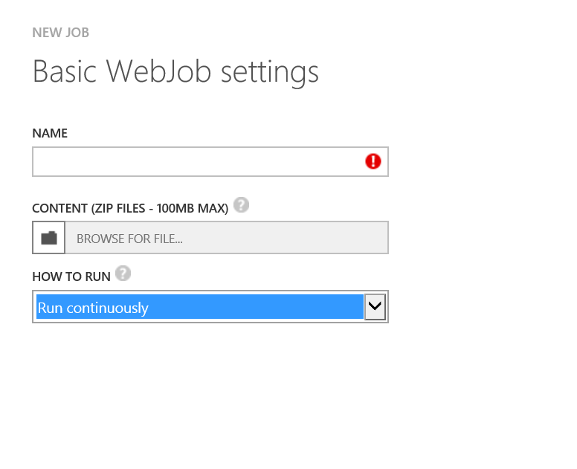
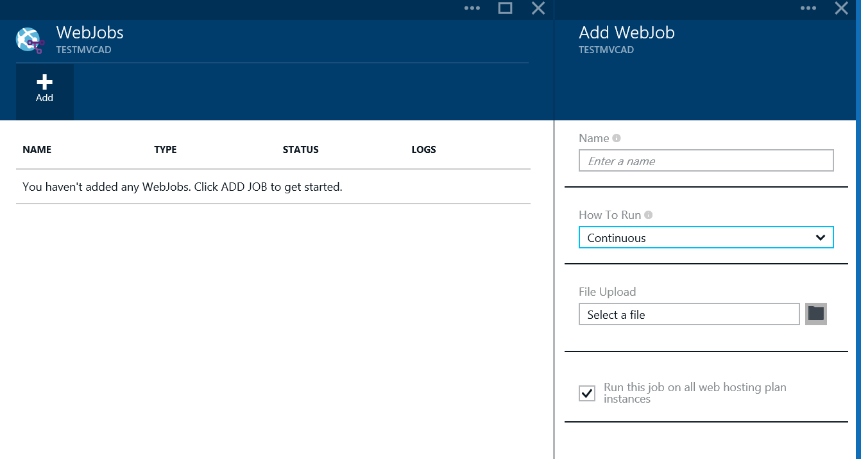
Configuring WebJobs
Notes:
This slide is required. Do NOT delete. This should be the first slide after your Title Slide. This is an important year and we need to arm our attendees with the information they can use to Grow Share! Please ensure that your objectives are SMART (defined below) and that they will enable them to go in and win against the competition to grow share. If you have questions, please contact your Track PM for guidance. We have also posted guidance on writing good objectives, out on the Speaker Portal (https://www.mytechready.com).
This slide should introduce the session by identifying how this information helps the attendee, partners and customers be more successful. Why is this content important?
This slide should call out what’s important about the session (sort of the why should we care, why is this important and how will it help our customers/partners be successful) as well as the key takeaways/objectives associated with the session. Call out what attendees will be able to execute on using the information gained in this session. What will they be able to walk away from this session and execute on with their customers.
Good Objectives should be SMART (specific, measurable, achievable, realistic, time-bound). Focus on the key takeaways and why this information is important to the attendee, our partners and our customers.
Each session has objectives defined and published on www.mytechready.com, please work with your Track PM to call these out here in the slide deck.
If you have questions, please contact your Track PM. See slide 5 in this template for a complete list of Tracks and TPMs.

Slide 49
CODE
AZURE FUNCTIONS
EVENTS + DATA
+
Notes:
Speaker Guidance: Briefly introduce this slide, while talking more deeply about functions, but remember to not steal too much time from the next slide.
Key talking points:
Events happen, all the time. Users browse your website, data is uploaded/downloaded or moved, messages are sent and received. All across the IT landscape actions are creating events, but are you taking full advantage of them? Imagine if you could react to events happening across your app portfolio in real time, what would you do?
Azure Functions extends Azure’s application platform by offering serverless compute for event-driven solutions. Azure Functions lets developers easily handle tasks that respond to events common in web and mobile applications, IoT and big data scenarios. Azure Functions works with Azure and third party services, automatically scales out to meet demand and only charges for the time your function runs.
With an open source runtime, developers will be able host Functions anywhere - on Azure, in your datacenter or on other clouds.
Azure Functions allows developers to program functions in JavaScript, C#, Python and PHP or scripting options such as Bash, Batch, and PowerShell using either an intuitive, web-based development environment that allows you to develop directly against your function or by uploading pre-compiled function written in the development tool of your choice.
Pre built Input/Output bindings provide a means of pulling or pushing data to many of the most common Azure 3rd party services, saving developers from having to build these bindings themselves. However, the open source nature of Azure Functions allows you to build your own bindings for services not already supported.

Slide 50
Azure functions
Asynchronous, event-driven, serverless experience
Respond to events occurring in other Azure services, SaaS products (e.g., Office365, Salesforce), on-premises systems
Only pay while function is executing
Fully open source
AZURE FUNCTIONS
Notes:
Speaker Guidance: Talk about the benefits..
Key talking points:
Azure Functions is in public preview. Azure Functions offers a serverless, microcompute, event-driven service with full Azure platform integration that extends the existing Azure application platform with capabilities to implement code triggered by events occurring in other Azure services, SaaS products, and on-premises systems:
Respond to any event: Azure Functions extends Azure’s market leading PaaS platform, extending the existing WebJobs infrastructure to let developers easily implement code that reacts to events generated from across the breadth of Azure. Whether you want to respond to changes in Azure storage containers, events emitted in SaaS products that support Web Hooks, or by calls to an HTTP endpoint. They're all easy to set up and require minimal configuration.
Develop your way: Implement events in a variety of languages (JavaScript, C#, Python and PHP), as well as scripting options like Bash, Batch, and PowerShell, using an intuitive web based user experience or upload and trigger pre-compiled executables built in the development tool of your choice.
Integrated DevOps: Quickly and easily iterate on your Azure Functions with continuous deployment using Visual Studio Team Services, GitHub or BitBucket. Monitor and troubleshoot your Azure Functions using the embedded logging environment.
Pay for what you use: With Azure Functions you will only be charged for the time your code is running. When an Azure Function is invoked it will be provided with as many resources as it needs to execute only for as long as it is executing.
Built for the Enterprise: Invoke your functions when events occur in internal APIs or business systems, then output the results to your on-premises databases or business solutions. Make your Azure Functions truly secure by hosting them on an App Service Environment that can be configured to be addressable only from internal networks.
Fully open-source, based upon the Kudu project and with an open source SDK and open source portal experience.

Slide 51
Modernization with microservices
WEB
HTTP Listener
Page content
Authenticator
Individually built and deployed
Small, independently executing services
Integrate using published API calls for overall application’s functionality
Fine-grained, loosely coupled application
BUSINESS LOGIC
Usage Analytics
Order Management
Reporting
DATA
Product Inventory
Customer Database
Notes:
Speaker Guidance: Take enough time to explain, and get audience questions. If you get questions about containers, defer to next slide.
The term “microservice” emphasizes the fact that applications should be composed of services small enough to truly implement a single role. Each has well-defined contracts (API contracts) for other microservices to communicate and share data with it. Microservices must also be able to version and update independently of each other. This loose coupling is key to supporting rapid and reliable evolution of an application. What would have been a single tier of a monolithic application decomposes into many discrete microservices, each independent and isolated.

Slide 52
Azure Service Fabric
Microservices Platform
Manage microservices at scale
CI/CD pipeline endpoint
24x7 service availability
Stateful services
Containers and Docker
Multi-cloud
MICROSERVICES PLATFORM
SERVICE FABRIC
Lifecycle management
Highly Scalable
24x7 availabilty
Cost efficient
Hybrid
Public Cloud
Private Cloud
Hosted Cloud
Notes:
Speaker Guidance: You may need to cover containers here to help differentiate them. (Containers are used in microservices, too, but you have to manage the OS. Service Fabric provides a large number of services in addition to make managing a microservice framework easy.)
Run on Windows, C++/C#
Linux + Java under development
Health models for infrastructure and microservices
Support for stateless and stateful microservices
Includes “actor programming model”
Integrated with Visual Studio
Pluggable into continuous integration (CI) and continuous delivery (CD)
Container
When to use it
The primary Service Fabric scenario is for building highly scalable, always on services that can be updated with zero downtime (like the Microsoft first party services mentioned previously). Use Service Fabric when you are creating a new app or re-writing an existing app to leverage microservices, have committed to a cloud-first architecture, and require rolling version updates with no downtime, distributed scalability and high performance, and low-latency data read and write.

Slide 53




Cloud services PaaS with VM control
CODE
CONFIG
Simple .NET runtime
Health, discovery, updates
OS Patching
The original PaaS offering from 2010. Best used when low-level OS access is required, but consider the newer PaaS models first.
Cloud Service
Web roles
Worker roles
Azure Storage
Notes:
Cloud Services is designed to support applications that are scalable, reliable, and cheap to operate. Just like an App Service is hosted on VMs, so too are Cloud Services, however, you have more control over the VMs. You can install your own software on Cloud Service VMs and you can remote into them.
More control also means less ease of use; unless you need the additional control options, it's typically quicker and easier to get a web application up and running in Web Apps in App Service compared to Cloud Services.
The technology provides two slightly different VM options: instances of web roles run a variant of Windows Server with IIS, while instances of worker roles run the same Windows Server variant without IIS. A Cloud Services application relies on some combination of these two options.
For example, a simple application might use just a web role, while a more complex application might use a web role to handle incoming requests from users, then pass the work those requests create to a worker role for processing. (This communication could use Service Bus or Azure Queues.)
Even though applications run in virtual machines, it's important to understand that Cloud Services provides PaaS, not IaaS. All you have to do is deploy your application. Management of the platform it runs on, including deploying new versions of the operating system, is handled for you.
Cloud Services is an effective solution when you need direct access to the underlying infrastructure or need to configure Internet Information Services (IIS) directly. Like App Service, you don’t need to deal with patching or updating the underlying OS. Cloud Services is sometimes used to migrate existing web apps with dependencies on IIS configurations or required third party components—it provides autoscaling while still allowing for many developer-focused platform benefits.
Since Cloud Services was introduced, design options have evolved significantly. App Service and Service Fabric reflect a more modern approach to PaaS that you should consider as the foundation for your application development.

Slide 54
API Management
Create Managed APIs
API Gateway + Developer Portal + Publisher Portal
Key Concepts
Rate Limits
Policies
Customize the Developer Portal
Add Caching
API Inspector to trace calls

Slide 55
Exam Outline (Skills measured)
Virtual Machines
Storage
Web & Mobile
Identity & Networks

Slide 56

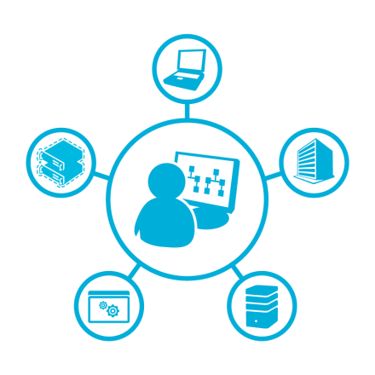
Identity and Networks
Azure AD
AD B2B/B2C
Communicate
Messaging
Notes:
This slide is required. Do NOT delete. This should be the first slide after your Title Slide. This is an important year and we need to arm our attendees with the information they can use to Grow Share! Please ensure that your objectives are SMART (defined below) and that they will enable them to go in and win against the competition to grow share. If you have questions, please contact your Track PM for guidance. We have also posted guidance on writing good objectives, out on the Speaker Portal (https://www.mytechready.com).
This slide should introduce the session by identifying how this information helps the attendee, partners and customers be more successful. Why is this content important?
This slide should call out what’s important about the session (sort of the why should we care, why is this important and how will it help our customers/partners be successful) as well as the key takeaways/objectives associated with the session. Call out what attendees will be able to execute on using the information gained in this session. What will they be able to walk away from this session and execute on with their customers.
Good Objectives should be SMART (specific, measurable, achievable, realistic, time-bound). Focus on the key takeaways and why this information is important to the attendee, our partners and our customers.
Each session has objectives defined and published on www.mytechready.com, please work with your Track PM to call these out here in the slide deck.
If you have questions, please contact your Track PM. See slide 5 in this template for a complete list of Tracks and TPMs.

Slide 57





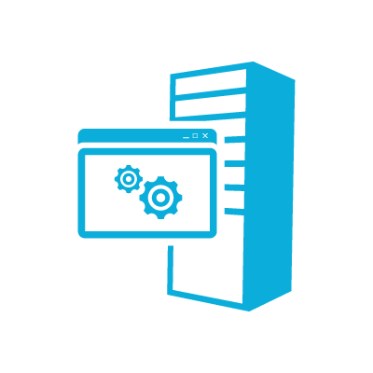
Azure Active Directory
Exchange
Online
SharePoint
Online
Graph API
Cloud Apps
Azure Active Directory
CLOUD
ON PREMISE
Active Directory
Exchange
SharePoint
LDAP
LOB Apps
Notes:
This slide is required. Do NOT delete. This should be the first slide after your Title Slide. This is an important year and we need to arm our attendees with the information they can use to Grow Share! Please ensure that your objectives are SMART (defined below) and that they will enable them to go in and win against the competition to grow share. If you have questions, please contact your Track PM for guidance. We have also posted guidance on writing good objectives, out on the Speaker Portal (https://www.mytechready.com).
This slide should introduce the session by identifying how this information helps the attendee, partners and customers be more successful. Why is this content important?
This slide should call out what’s important about the session (sort of the why should we care, why is this important and how will it help our customers/partners be successful) as well as the key takeaways/objectives associated with the session. Call out what attendees will be able to execute on using the information gained in this session. What will they be able to walk away from this session and execute on with their customers.
Good Objectives should be SMART (specific, measurable, achievable, realistic, time-bound). Focus on the key takeaways and why this information is important to the attendee, our partners and our customers.
Each session has objectives defined and published on www.mytechready.com, please work with your Track PM to call these out here in the slide deck.
If you have questions, please contact your Track PM. See slide 5 in this template for a complete list of Tracks and TPMs.

Slide 58
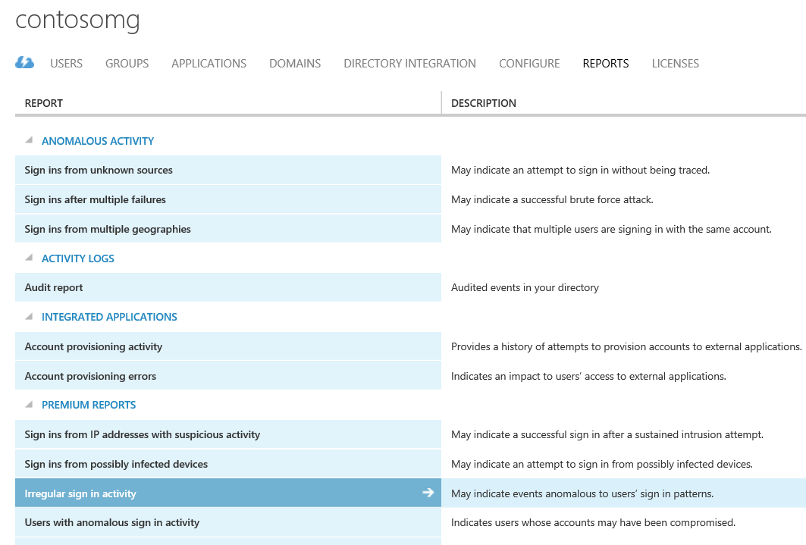
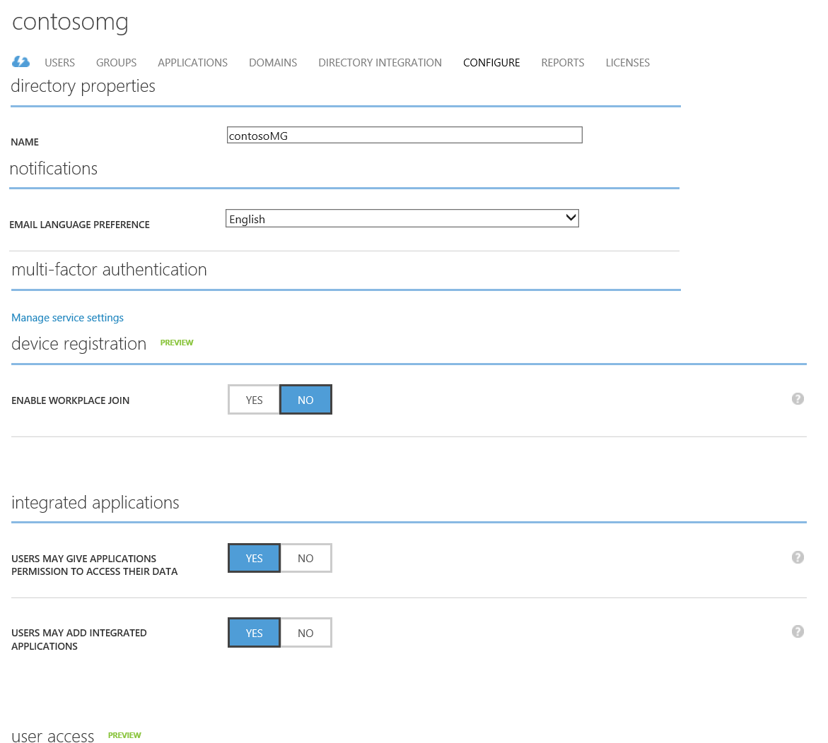
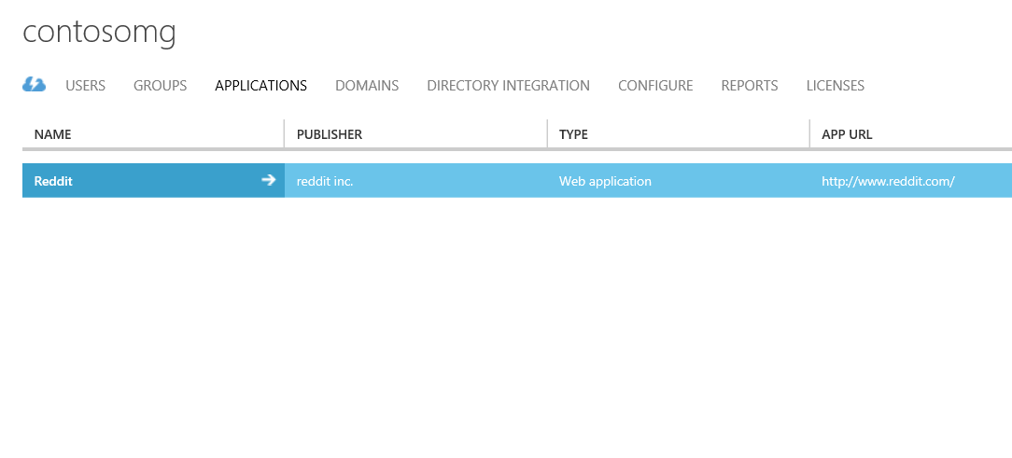
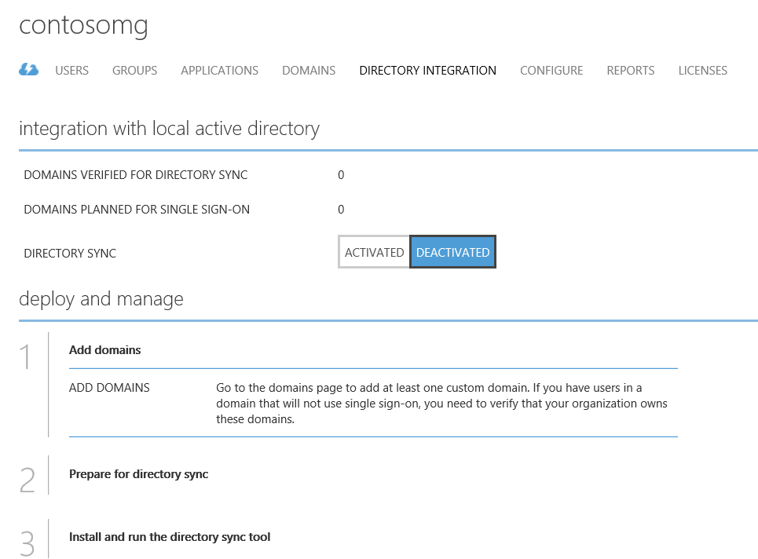
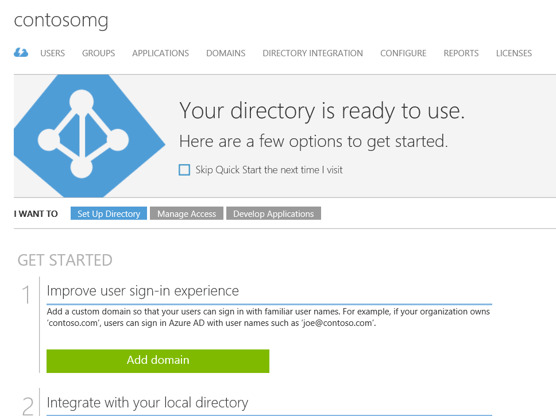
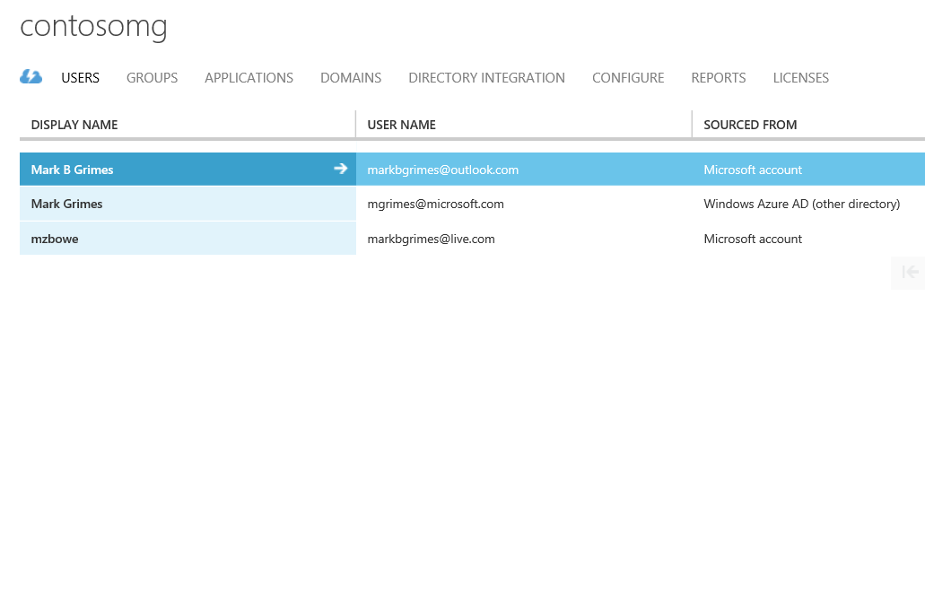
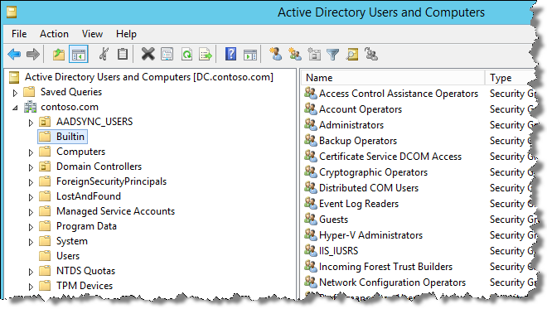
Secure Resources using Managed Identities
AD On-premises vs Azure AD
Graph API
Programmatic Access to Azure AD | RESTful
CRUD | Application must be registered and configured
Requests use standard HTTP Methods
OAuth
AuthZ web apps and web APIs in Azure AD Tenant
Access authorization, role-based assignment
for app and user authorization
OpenID Connect
AuthZ protocol for SSO
Extends Oauth 2.0 for use as AuthN protocol
Notes:
Manage identity, application, and network services (15‒20%)
Integrate an app with Azure Active Directory (Azure AD)
Develop apps that use WS-federation, OAuth, and SAML-P endpoints; query the directory using Graph API

Slide 59




Azure Business to Consumer (B2C)
Sign up, Sign in, Password reset & other policies
Social & Local Accounts
Seamless User Experience
Multi-Factor Authentication
••••••••••
••••••••••
Protocol support
(OIDC, OAuth2)
Azure AD
Graph API
aka.ms/Azure/B2C
Notes:
For consumer- & citizen-facing mobile & web apps
Self-service & seamless identity experiences
Configure Facebook, Google+, Microsoft account, Amazon, and LinkedIn accounts for use in your consumer-facing applications.
Enable Azure Multi-Factor Authentication in your consumer-facing applications.
Set up self-service password reset for your consumers.
Customize the look and feel of sign up, sign in, and other consumer-facing pages that are served by Azure Active Directory B2C.
Use the Azure Active Directory Graph API to programmatically create, read, update, and delete consumers in your Azure Active Directory B2C tenant.
Get started
To build an application that accepts consumer sign up and sign in, you'll first need to register the application with an Azure Active Directory B2C tenant
You can write your application against the Azure Active Directory B2C service either by choosing to send protocol messages directly, using OAuth 2.0 or Open ID Connect, or by using our libraries to do the work for you

Slide 60
Azure B2B viral tenant created
arvind@b2btest074.com added to msonline-setup.com tenancy
Arvind can choose not to create account. If not, the invitation remains unredeemed.
b2btest074.onmicrosoft.com is the tenant domain and contoso.com is an email verified domain.
Admin can DNS verify the b2btest074.com domain and take over this dynamic tenancy.
When the tenant is taken over -the domain changes to DNS verified.
Tenant can choose to keep existing cloud passwords for the users or configure On Prem federation if available.
Arvind_btbtest074. com#EXT#@...
msonline-setup.com
arvind@b2btest074.com
Guest Mail User
msonline-setup.com
(host tenant)
B2btest074.onmicrosoft.com
(dynamic tenant)
aka.ms/Azure/B2CB
Notes:
Guest addition flow where viral tenant is created
What is it for?
IT Pros providing access to their organization’s data and applications to partner organizations and collaborators.
Who is it for?
Partner users that are acting *on behalf of*, i.e. as representatives or employees of their organization.

Slide 61
B2C or B2B?
Azure AD B2B Collaboration | Azure AD B2C
What is it for?
IT Pros providing access to their organization’s data and applications to partner organizations and collaborators. | Developers working on Consumer- & citizen-facing mobile & web apps that reach out to the customer, and citizens directly.
Who is it for?
Partner users that are acting *on behalf of*, i.e. as representatives or employees of their organization. | Consumers and citizens that are acting as themselves.
Manageability
Access reviews, email verification, allowlist/denylist, etc… govern access to host application and resources. | Self-Serve. Users manage their own profiles.
Discoverability
Partner users are discoverable and can see other users from their own organization (subject to policy). | Consumers and citizens are invisible to other consumers and citizens. Privacy and consent are paramount.

Slide 62
Comparison of Azure AD capabilities
Consider this Product | Azure AD Multi-tenant SaaS app | Azure AD B2B | Azure AD B2C
If I need to provide | A service to businesses | Partner access to my apps | A service to consumers
And I am similar to | Pharm Distribution | Imaging company | Sports Franchise
Deploying an App for… | Practice Management | Supplier extranet | Soccer Fans
Targeting… | Doctor’s offices | Approved Business Partners | Anyone with email
Accessible when | Customer admin consents | My admin invites | The consumer signs up

Slide 63
Service Bus
Targeting Messages
Work with Queues
Push notification infrastructure
Support for non-MSFT targets
FIFO Queues
Simple Client
Expose OnPrem service to public
Leverage WCF
NOTIFICATION HUBS
QUEUES
TOPICS
RELAY
Notes:
This slide is required. Do NOT delete. This should be the first slide after your Title Slide. This is an important year and we need to arm our attendees with the information they can use to Grow Share! Please ensure that your objectives are SMART (defined below) and that they will enable them to go in and win against the competition to grow share. If you have questions, please contact your Track PM for guidance. We have also posted guidance on writing good objectives, out on the Speaker Portal (https://www.mytechready.com).
This slide should introduce the session by identifying how this information helps the attendee, partners and customers be more successful. Why is this content important?
This slide should call out what’s important about the session (sort of the why should we care, why is this important and how will it help our customers/partners be successful) as well as the key takeaways/objectives associated with the session. Call out what attendees will be able to execute on using the information gained in this session. What will they be able to walk away from this session and execute on with their customers.
Good Objectives should be SMART (specific, measurable, achievable, realistic, time-bound). Focus on the key takeaways and why this information is important to the attendee, our partners and our customers.
Each session has objectives defined and published on www.mytechready.com, please work with your Track PM to call these out here in the slide deck.
If you have questions, please contact your Track PM. See slide 5 in this template for a complete list of Tracks and TPMs.

Slide 64
Service Bus Queue vs Storage Queue
Service bus queues
FIFO guaranteed
Delivery once and only once
60 second default locks can be renewed
Messages are finalized once consumed
Native integration with WCF and WF
Storage queues
Order not guaranteed
Delivery at least once, maybe multiple times
30 second default locks, extendable to 7 days
In-place updates of content
Can integrate with WF through custom activity

Slide 65
This provides programmatic access to Azure AD
Remote PowerShell
LDIFDE
Graph API
OpenID Connect
OAuth
Graph API

Slide 66
Study Strategy

Slide 67
Microsoft Virtual Academy
Mastering Microsoft Certification Exam Prep
https://mva.microsoft.com/en-US/training-courses/mastering-microsoft-certification-exam-prep-16601

Slide 68

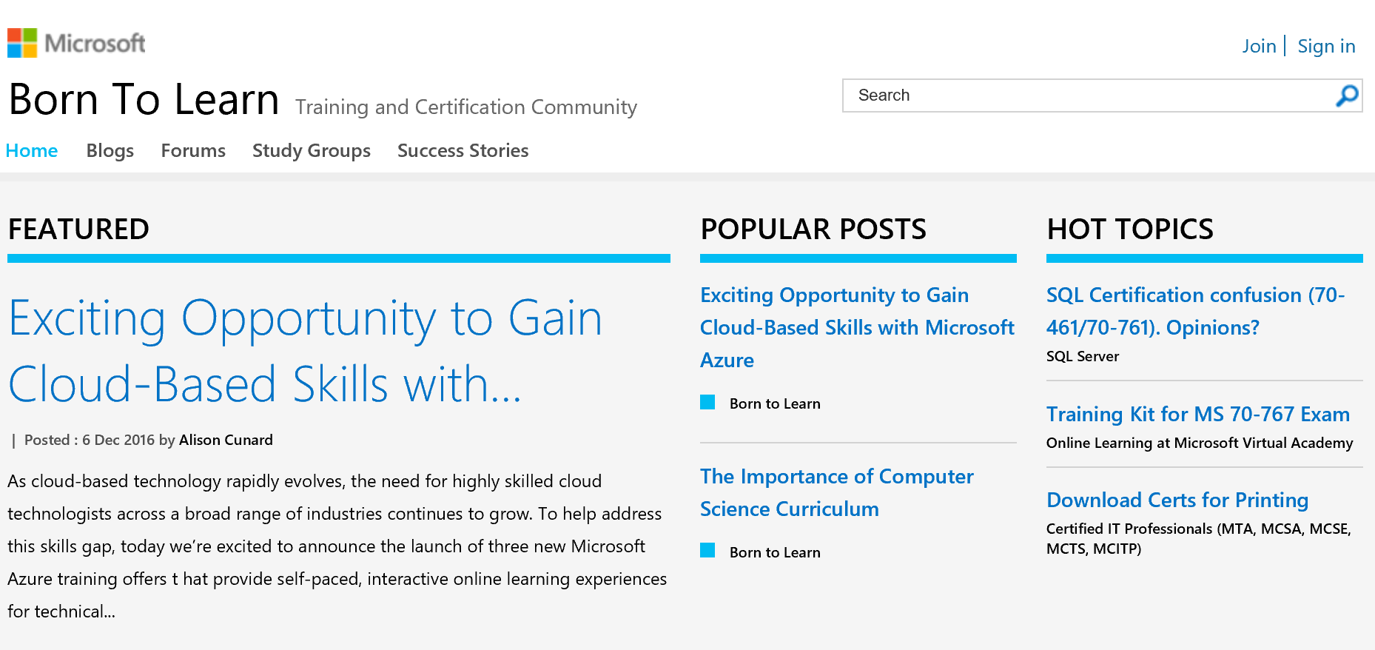
Study Groups https://borntolearn.mslearn.net/

Slide 69
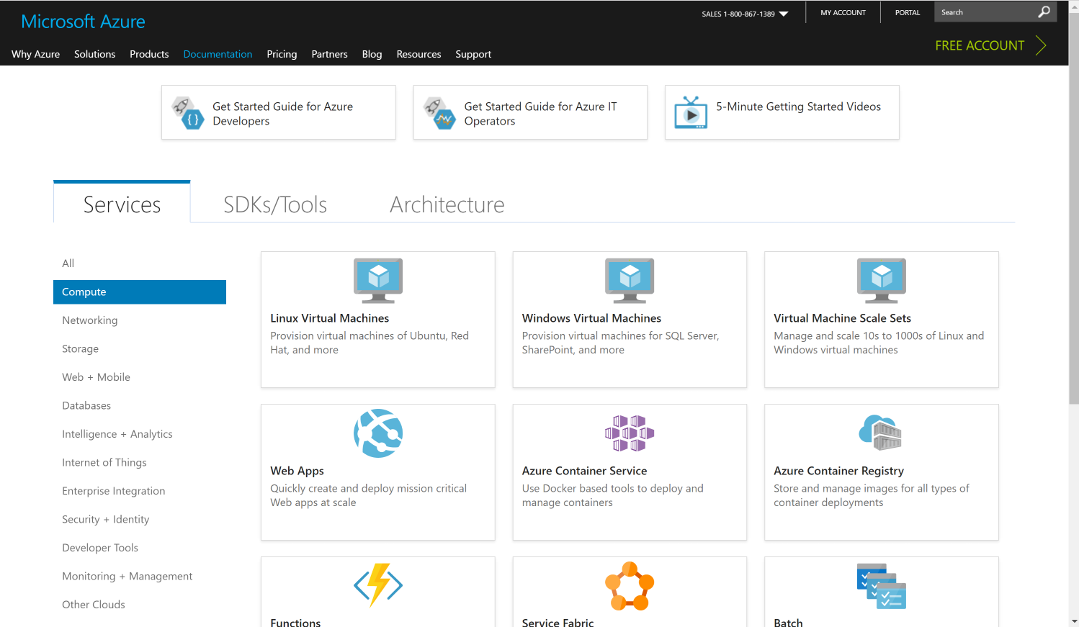
Azure Docs https://docs.microsoft.com/en-us/azure/index

Slide 70
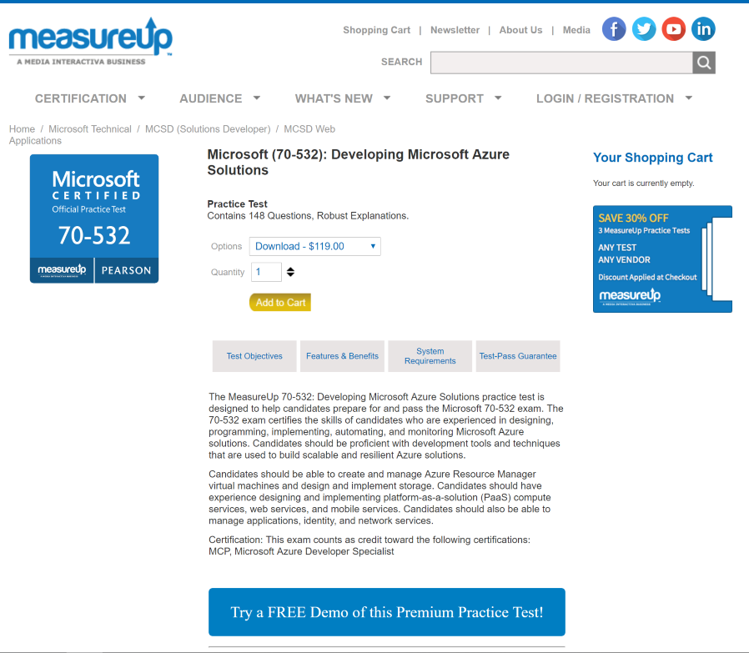
MeasureUp http://www.measureup.com/70-532-Developing-Microsoft-Azure-Solutions-P5566.aspx

Slide 71
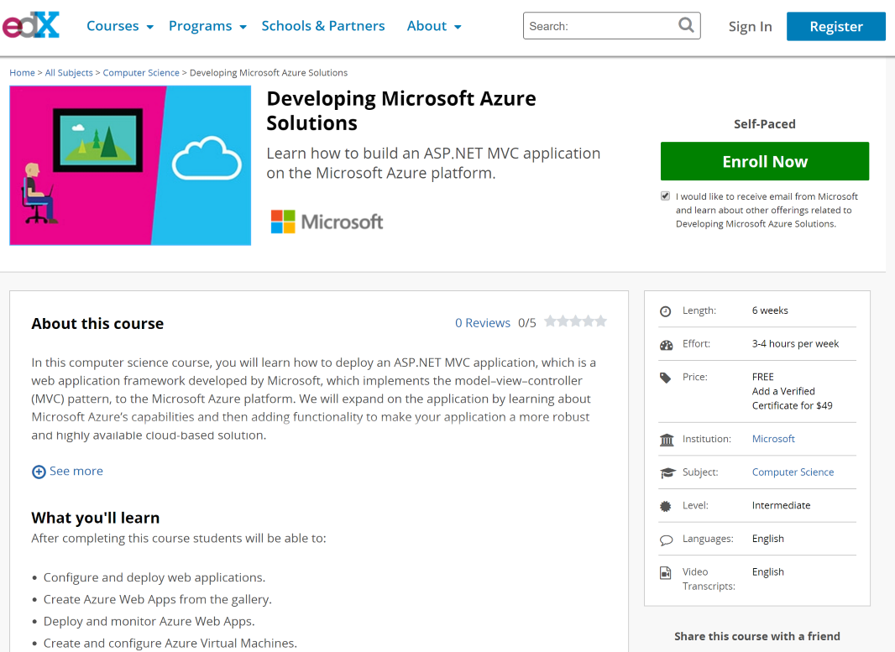
edX Course/Labs https://www.edx.org/course/developing-microsoft-azure-solutions-microsoft-dev233

Slide 72
Course 20532C:
Developing Microsoft Azure Solutions https://www.microsoft.com/en-us/learning/course.aspx?cid=20532

Slide 73
Case Study Strategy
Scan case
Look for theme(s)
Scan items
Map to the case
Answer the items
Use the case study extract as the item stem

